Slide 1
Classroom rules
Mrs. Davis

Slide 2
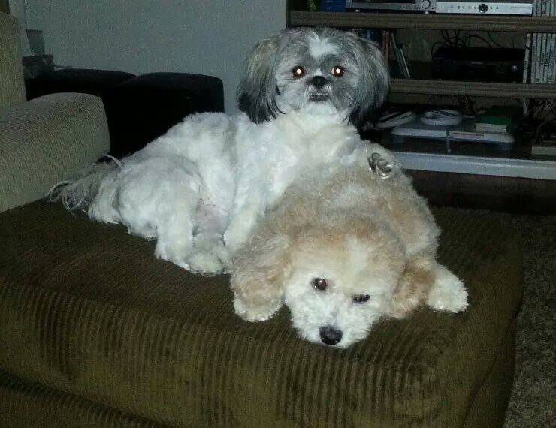


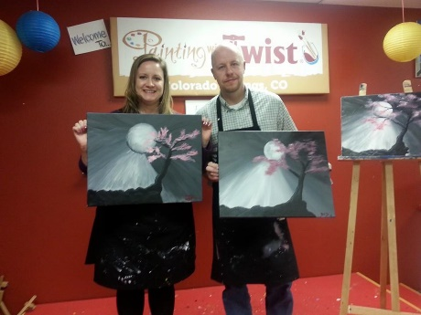
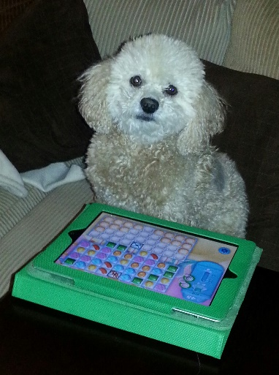



Mrs. Davis

Slide 3
CLASS RULES
Be Respectful
Be Responsible

Slide 4
Be Respectful
1. Take two minutes to jot down a list of behaviors that you consider to be respectful behaviors.
2. Discuss with your group members.

Slide 5

Notes:
Give everyone who has the floor the same respect. Raise your hand if you want to speak.

Slide 6


Slide 7


Slide 8
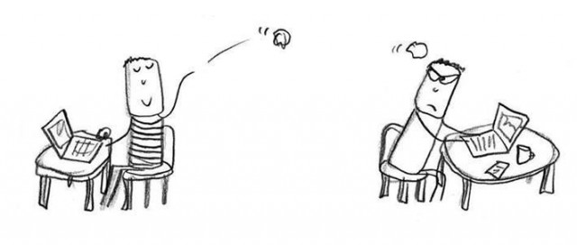

Slide 9

Notes:
No bullying, no fighting, etc

Slide 10
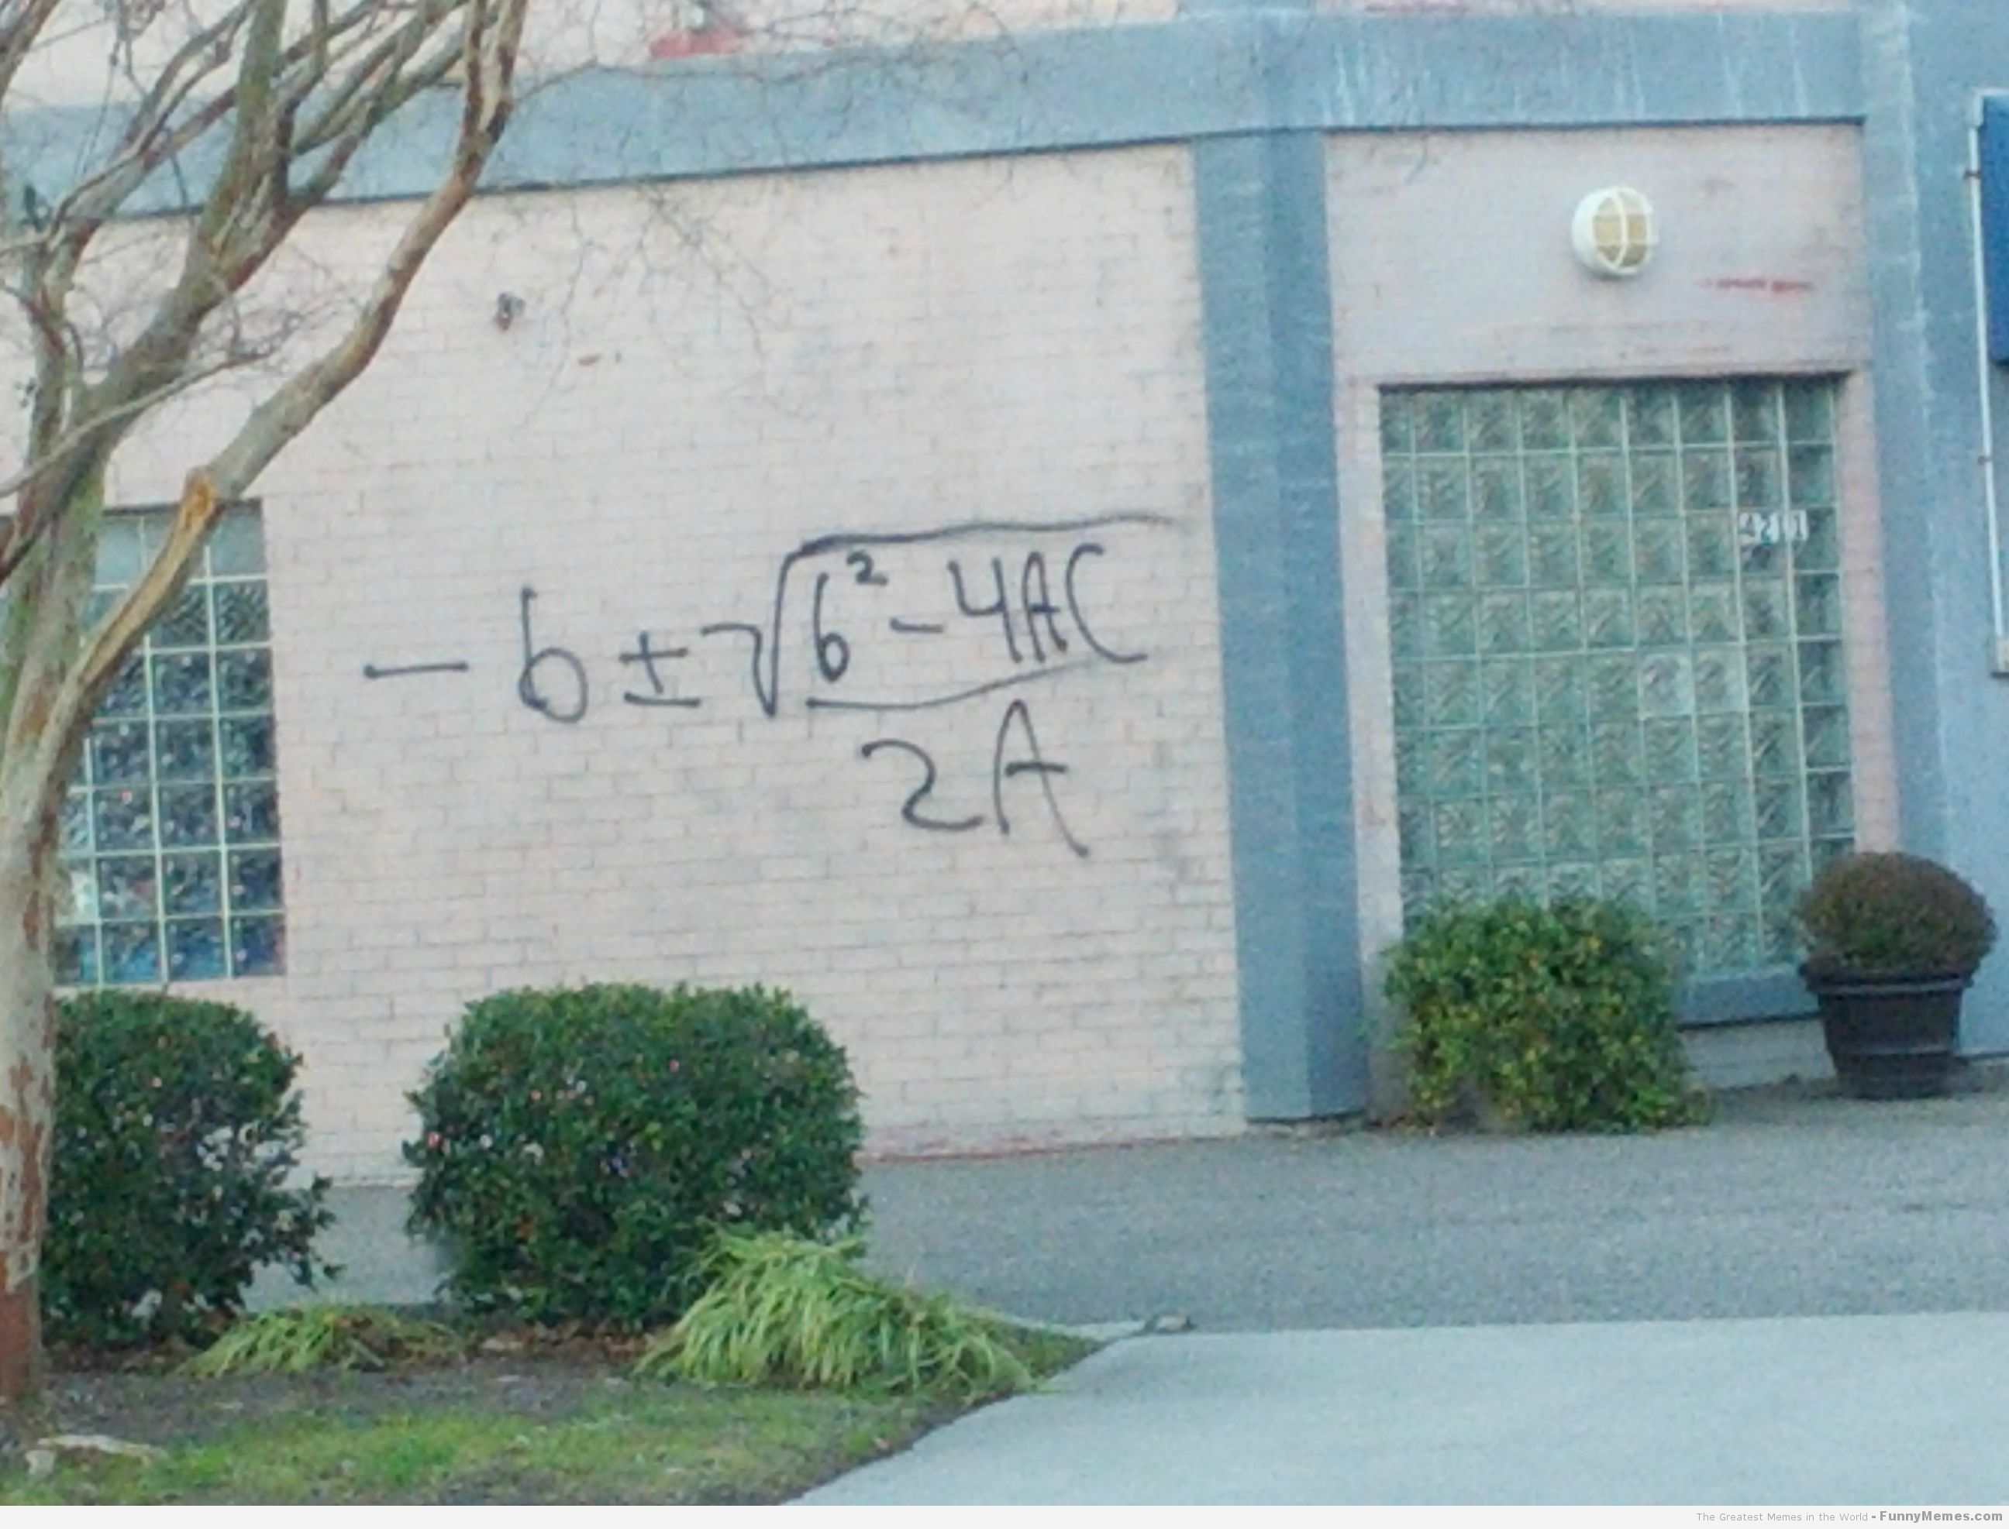
NO Vandalism

Slide 11
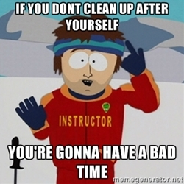

Slide 12


Slide 13
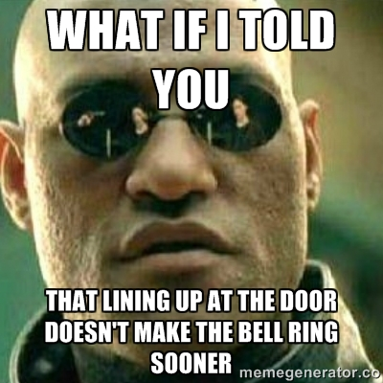

Slide 14
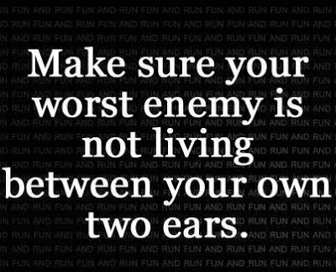

Slide 15
Be Responsible
1. Take two minutes to jot down a list of behaviors that you consider to be responsible behaviors.
2. Discuss with your group members.

Slide 16

Notes:
Bring your supplies to class.

Slide 17


Slide 18

Notes:
Where can you find out about what you missed while you were gone? Excused absences, unexcused, and activities

Slide 19
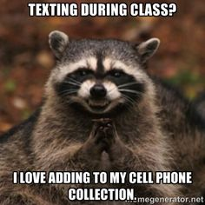
Notes:
Do not let technology interfere with your learning

Slide 20
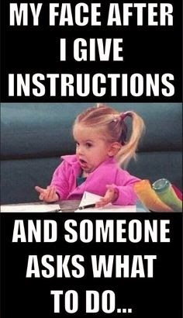
Notes:
Pay attention and follow the rules

Slide 21

Clearly a valedictorian in the making…
Notes:
Be actively involved in the learning process.

Slide 22


Slide 23
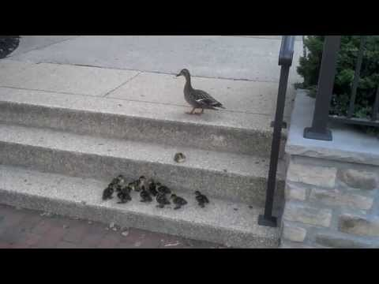
Never, ever give up!

Slide 24
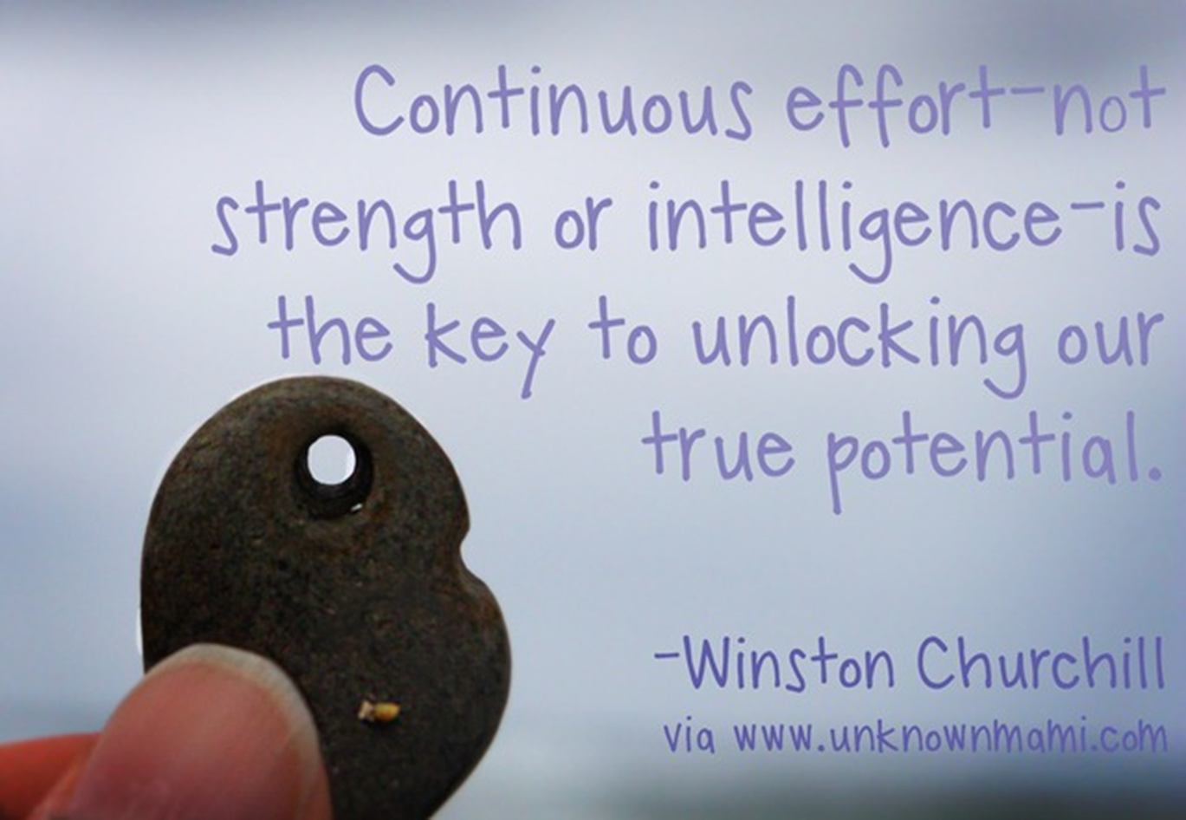

Slide 25


Slide 26

Notes:
Turn your work in on time and do not expect extra credit

Slide 27
You are free to choose, but you are not free from the consequences…
1st offense
  Warning and documentation
2nd offense
  Detention with teacher and phone call home
All subsequent offenses
  Discipline Referral
Some behaviors will result in an immediate referral.
Notes:
If you break the rules…

Slide 28
Immediate action…..
Immediate Referral
Profanity
Abusive Language
Obscene Gesture
Defiance
Property Damage
Theft
Inappropriate Use of Technology
Security Called
Verbal or Physical Aggression
Drugs/Alcohol/Tobacco/E-Ciggarettes
Bullying
Fighting
Gang Behavior
Arson
Weapon

